Slide 1


My Rural Placement Experience

Slide 2

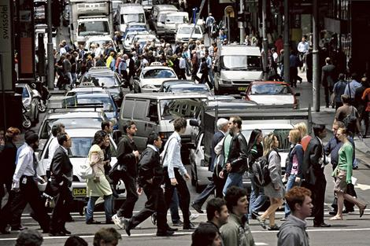

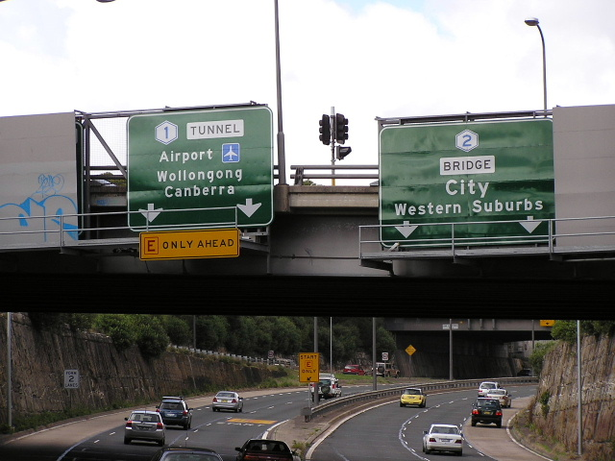

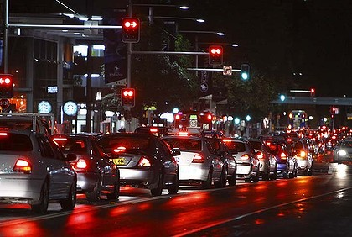
City Kid

Slide 3

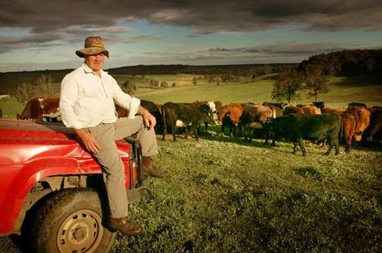
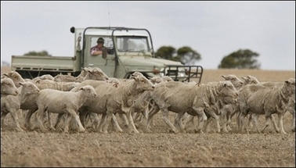
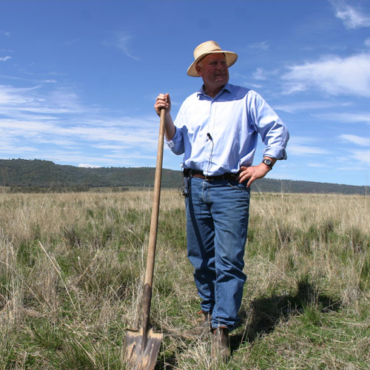
What To Expect…?
Rural Life…?

Slide 4
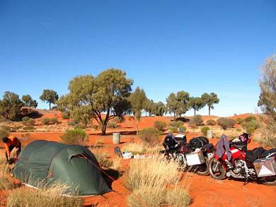
Accommodation
Tent…?

Slide 5
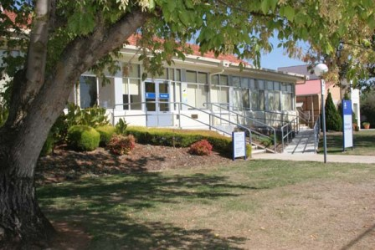
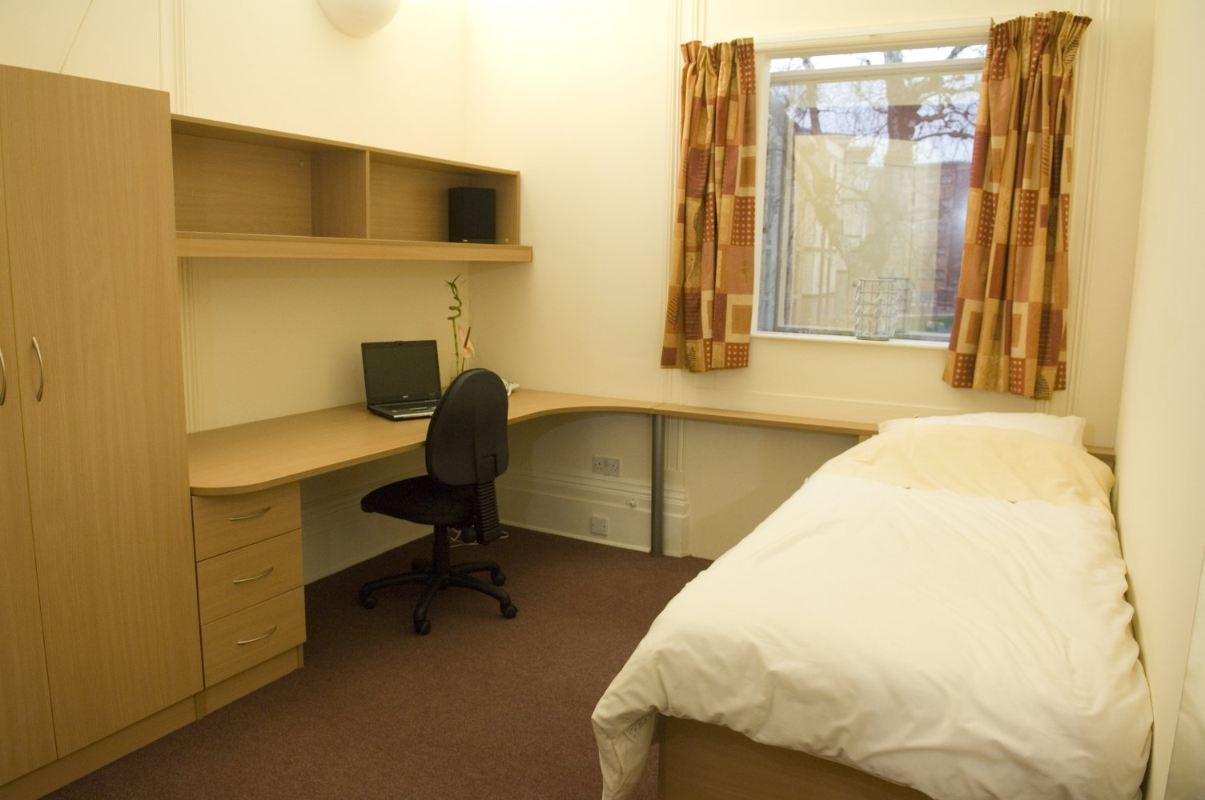
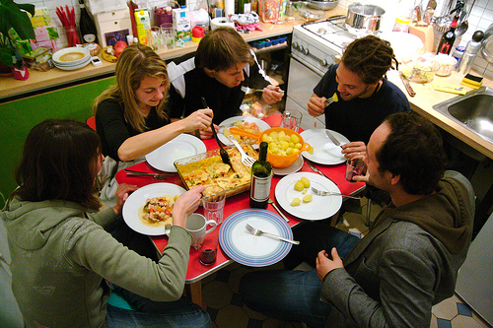
Accommodation
Onsite Student Accommodation

Slide 6



Finance…?

Slide 7
Finance…?
Rural Placement Grants and Scholarships

Slide 8
Placement
What to
Expect…?

Slide 9
Placement
What to
NERVOUS
Expect…?
Missing family & friends

Slide 10




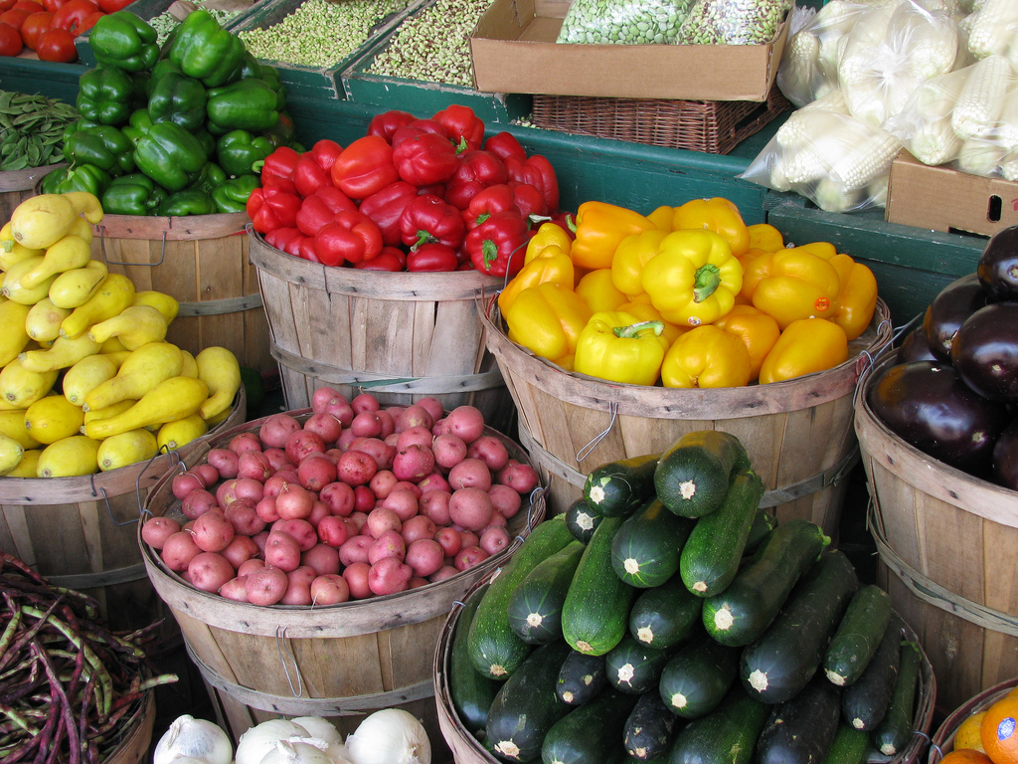
Nothing to worry about

Slide 11
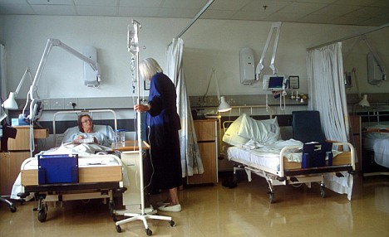



Slower Pace

Slide 12
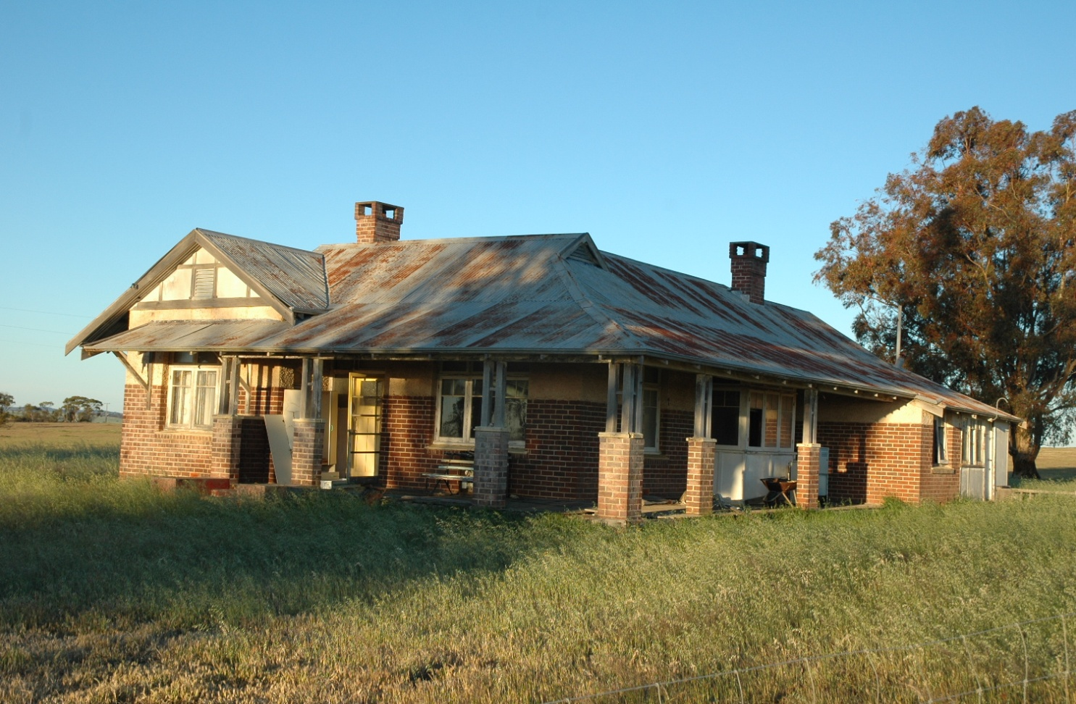


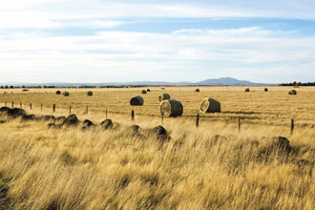
Home Visits

Slide 13


Generous with their time

Slide 14
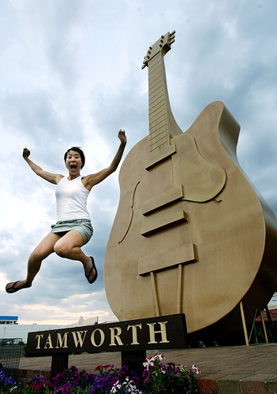
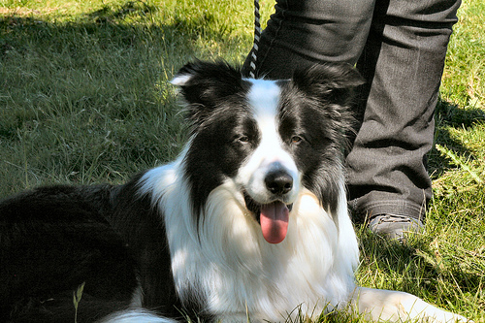
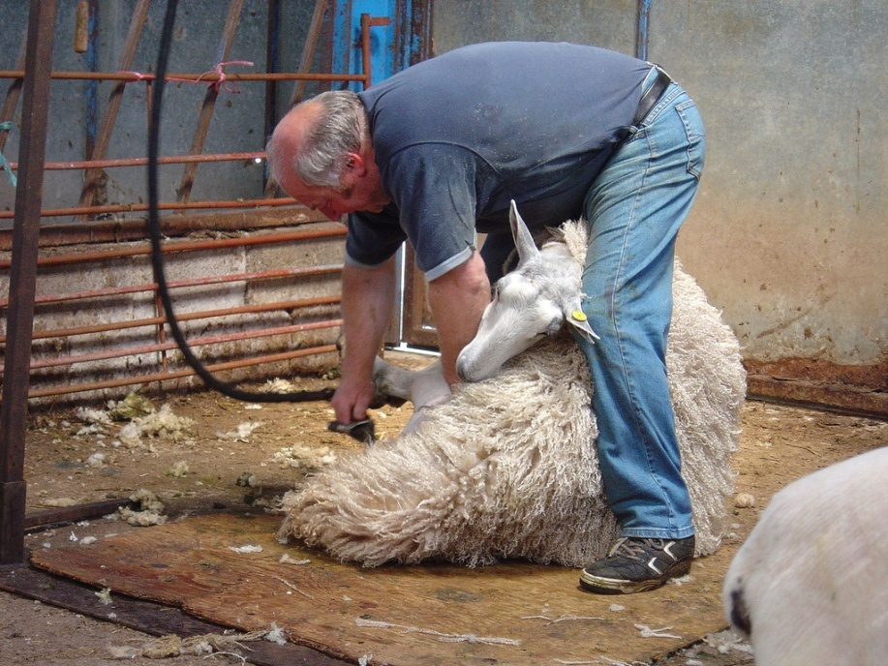
Weekend Trips

Slide 15
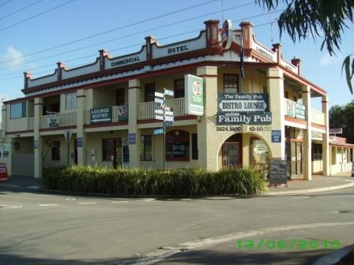

“Everyone really does know everyone in rural towns”

Slide 16
Rural Placement

Slide 17
Rural Placement
Flexible and adaptive in practice

Slide 18
Rural Placement
Flexible and adaptive in practice
Think outside the square

Slide 19
Rural Placement
Flexible and adaptive in practice
Think outside the square
Innovative and creative

Slide 20
My Rural Placement Experience
A brilliant opportunity!

